Slide 1
Administration

Slide 2
Publishing

Slide 3

Publishing
Publishing usually consists of up to three parts:
  Export SFTP
  Search G2
  Publishing Package
  Publishing Properties
Export SFTP and Publishing Packages can be set up in V3
  Settings > Publishing > Export SFTP
  Settings > Publishing > Packages

Slide 4
Publishing
Publishing Properties can only be configured in Volte
  Use Publishing in the Properties panel on the right rail
Search G2 can only be initially configured in Volte
  You must log in as cptadmin
  Settings > Configuration > General Search G2

Slide 5
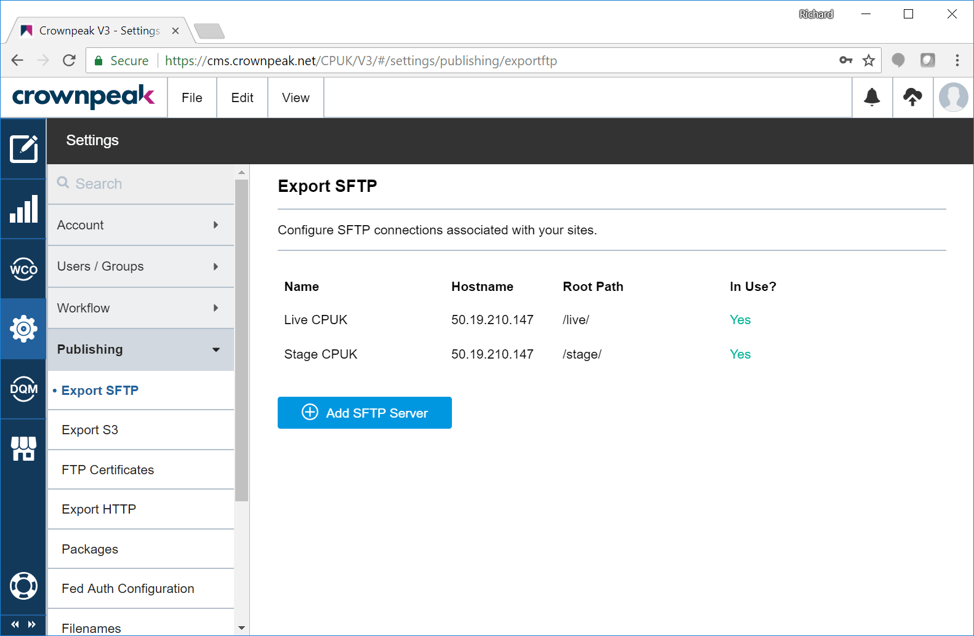
Export SFTP

Slide 6
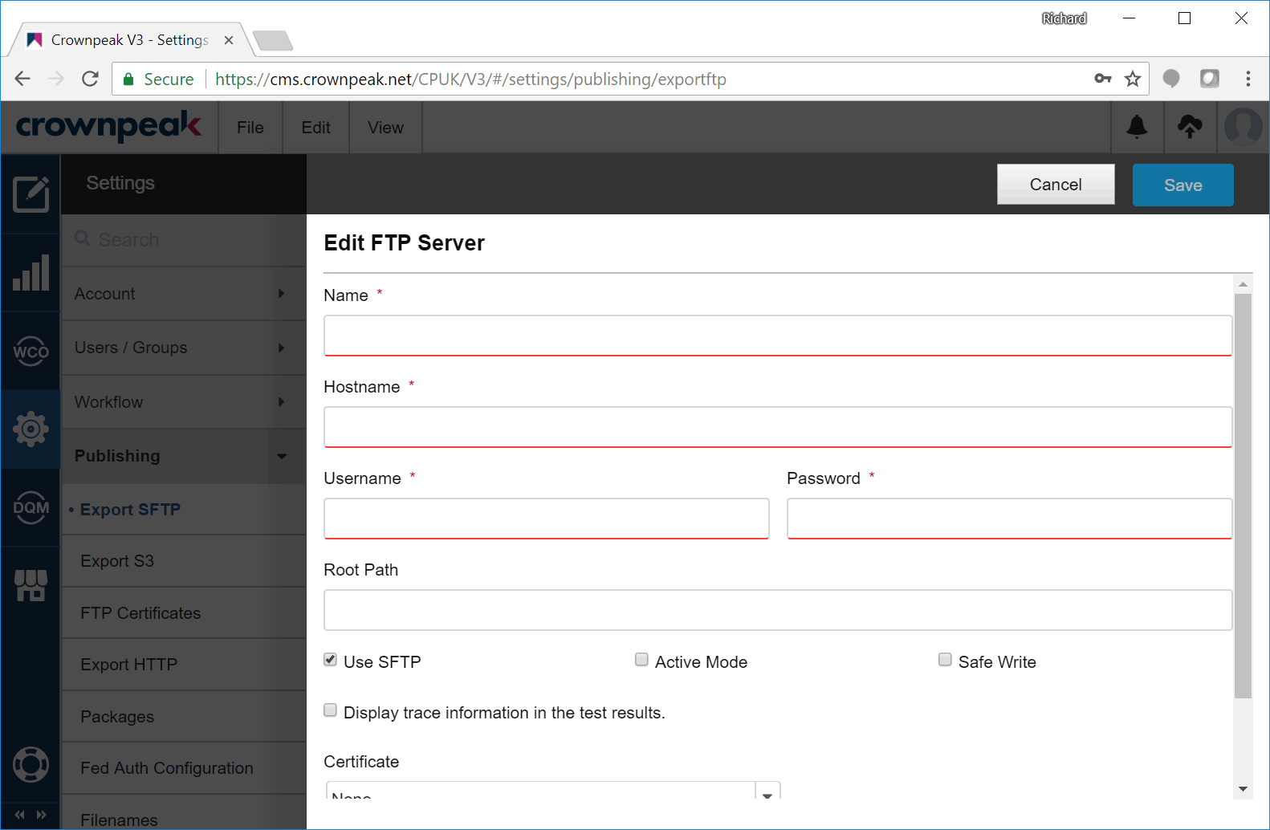
Export SFTP

Slide 7
Export SFTP
Add one Export SFTP entry for each server target
  Username/password will be provided via Secret Server
  Or IT may set these up for you
If multiple environments are on one server, only need one
  Set Root path above the environment folder
Render 1 Publish n needs n entries here
There’s a Test button/link to try it out after creation
  If this fails, go back to Operations with the details that it shows

Slide 8
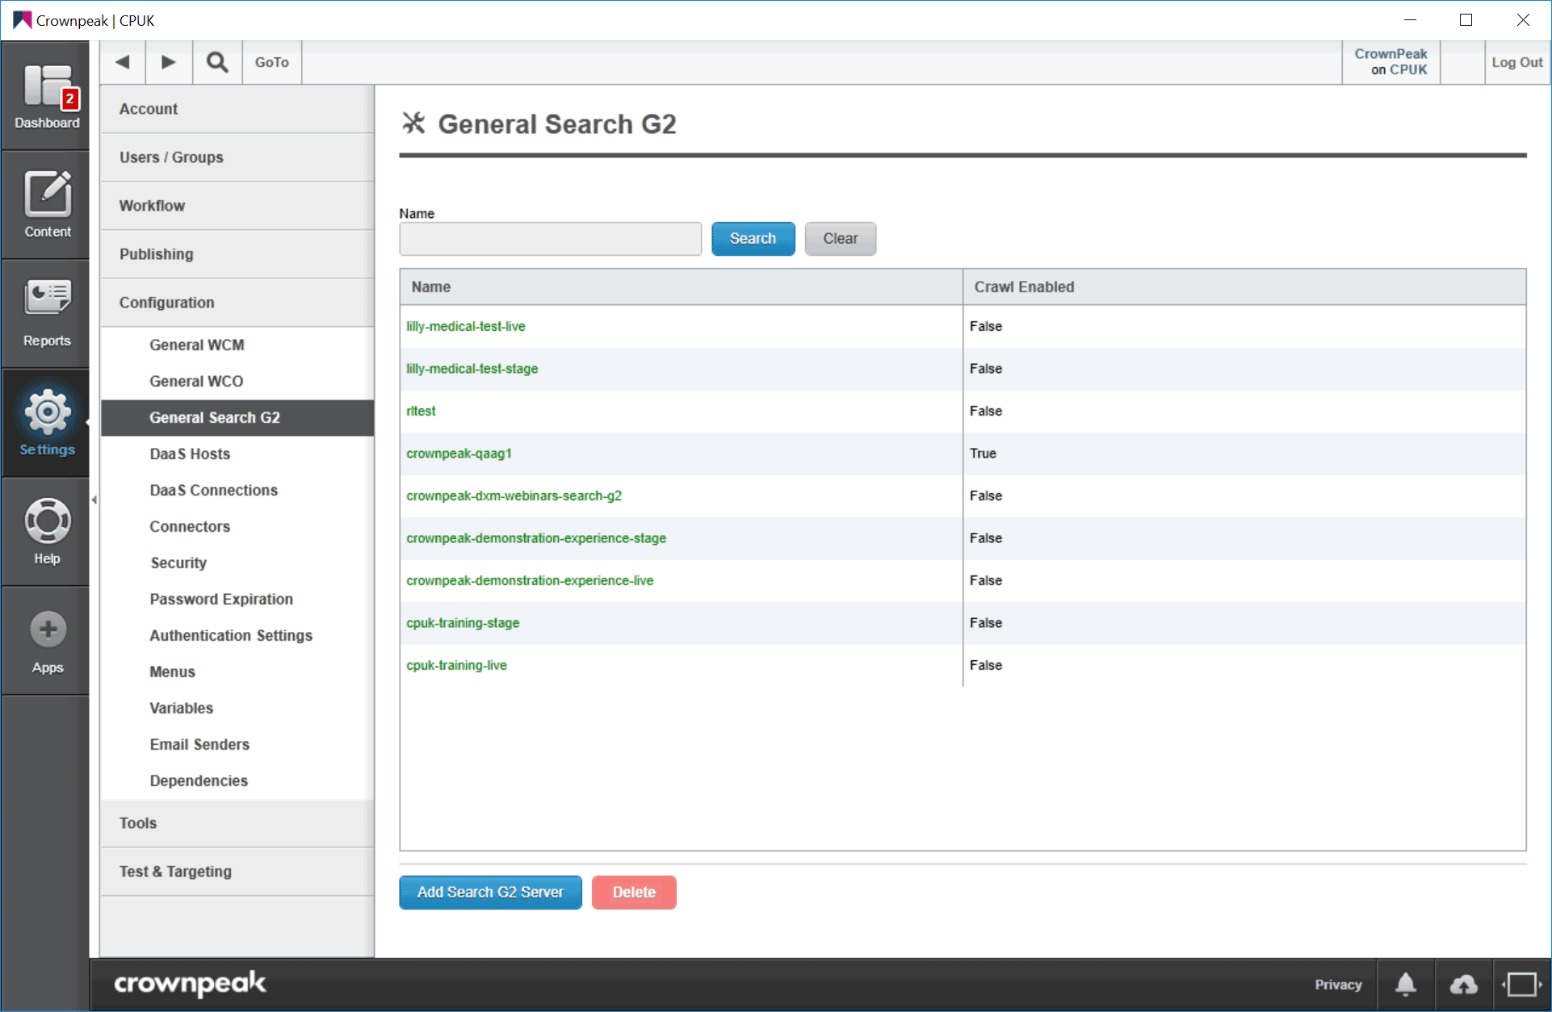
Search G2

Slide 9
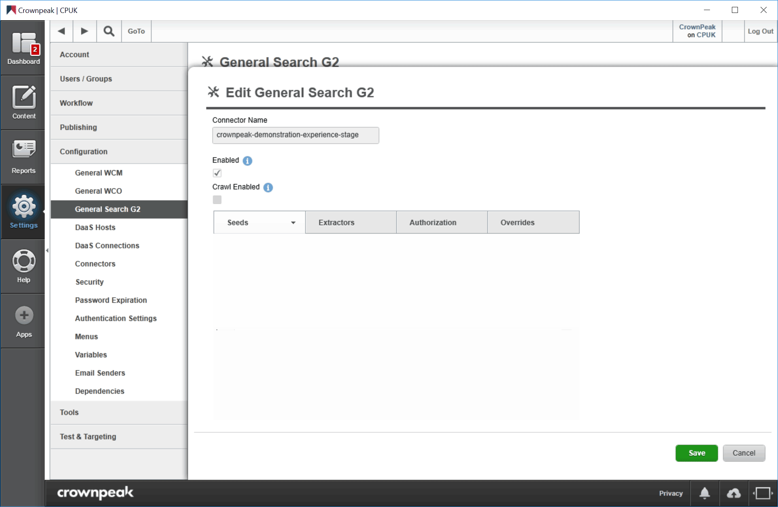
Search G2

Slide 10
Search G2
Add one entry for each environment using Realtime Indexing
Name the entry the same as the courtesy (without domain)
Check Enabled
DO NOT check Crawl Enabled
Leave the other boxes empty
For private collections, raise a ticket with IT, e.g. CPO-7218
  Copy a proxy page in the relevant language
  E.g. BNY Mellon IM for Java, or S&P Global for ASP.NET

Slide 11
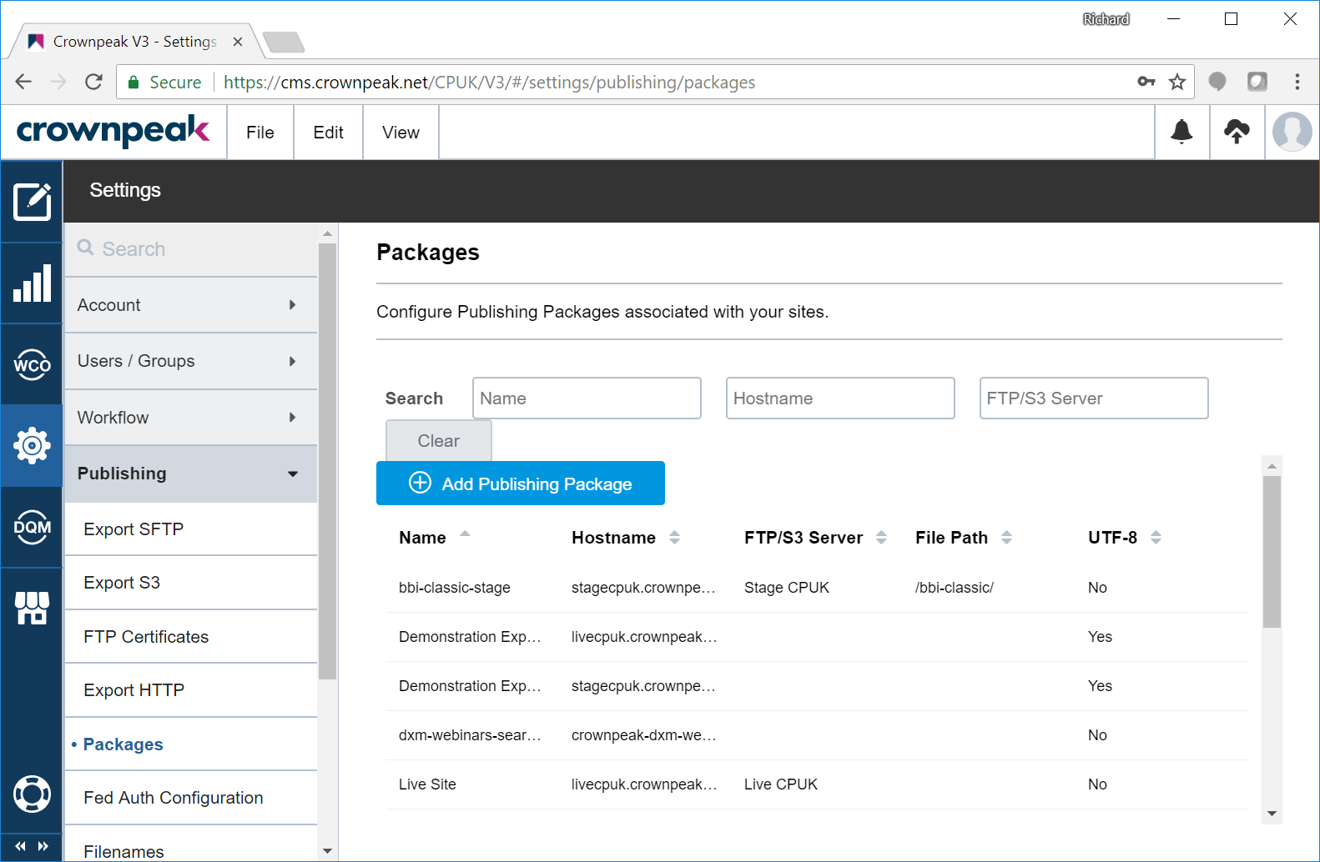
Packages

Slide 12

Packages

Slide 13
Packages
Add one Package for each environment for each site
The Hostname should be the domain for this environment
Typically set the path segment to come after that in the FTP
Add one FTP Server for each R1Pn destination
Choose a Search G2 Server if using Realtime Indexing
Choose a DQM connector if that’s licensed/configured

Slide 14
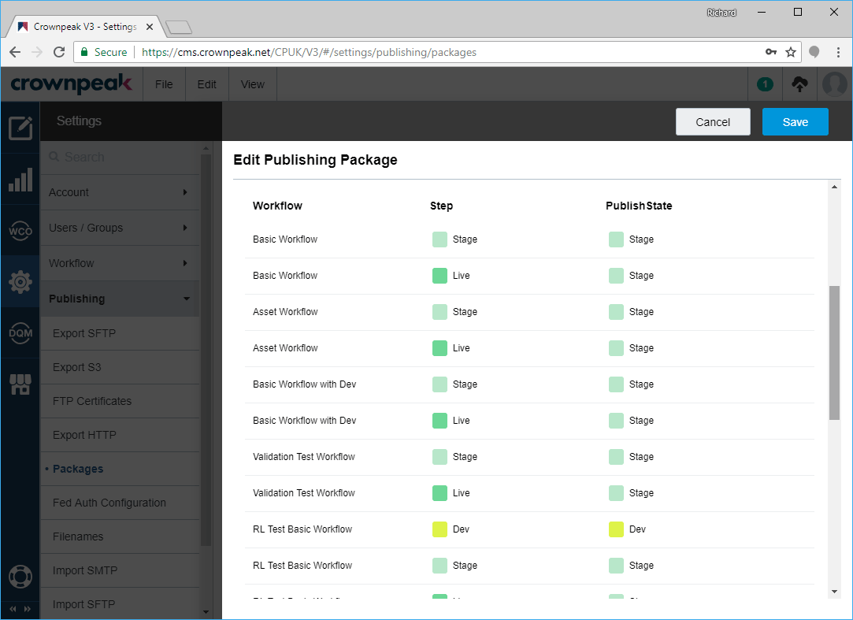
Packages

Slide 15
Packages
Packages have references to which workflow uses them
Add one row here for each workflow and environment combination
We publish back to all states
So the Live workflow step publishes to the Stage package
  And it uses the Stage Publish State
  This is complex!
This is what keeps all environments in sync
It’s not optional
  If there’s no entry for the Live step, that means Unpublish from Stage!

Slide 16
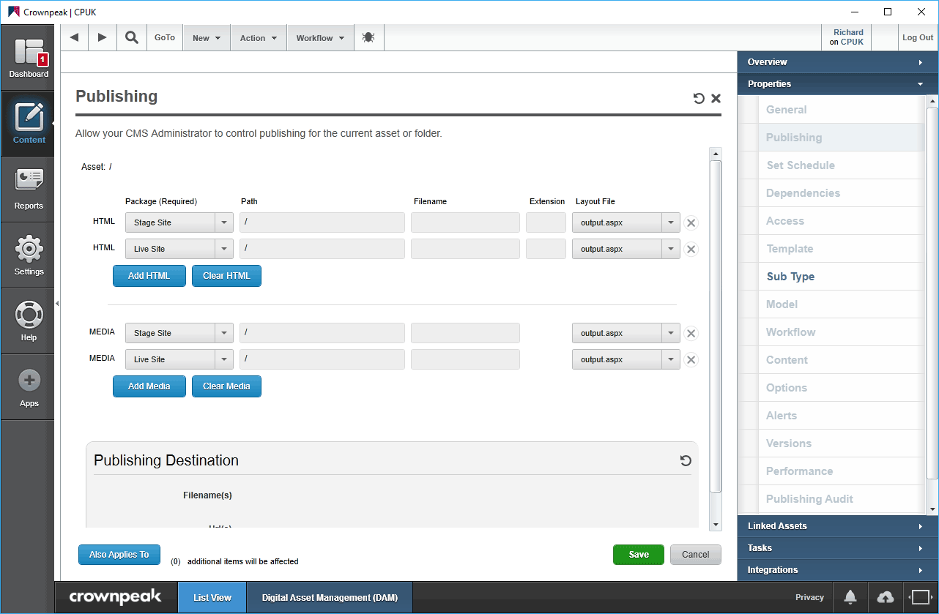
Publishing Properties

Slide 17
Publishing Properties
Typically one entry per environment
Can add multiples to support multiple outputs
Fill in twice – one for templated, one for digital assets
Properties inherit down unless overridden
If you want to turn off publishing for a folder:
  Use the NoPublish package
Publishing Properties can also be set on files
  Try not to do this – it increases complexity!
Reports > Assets > Publishing Properties can help you find them

Slide 18
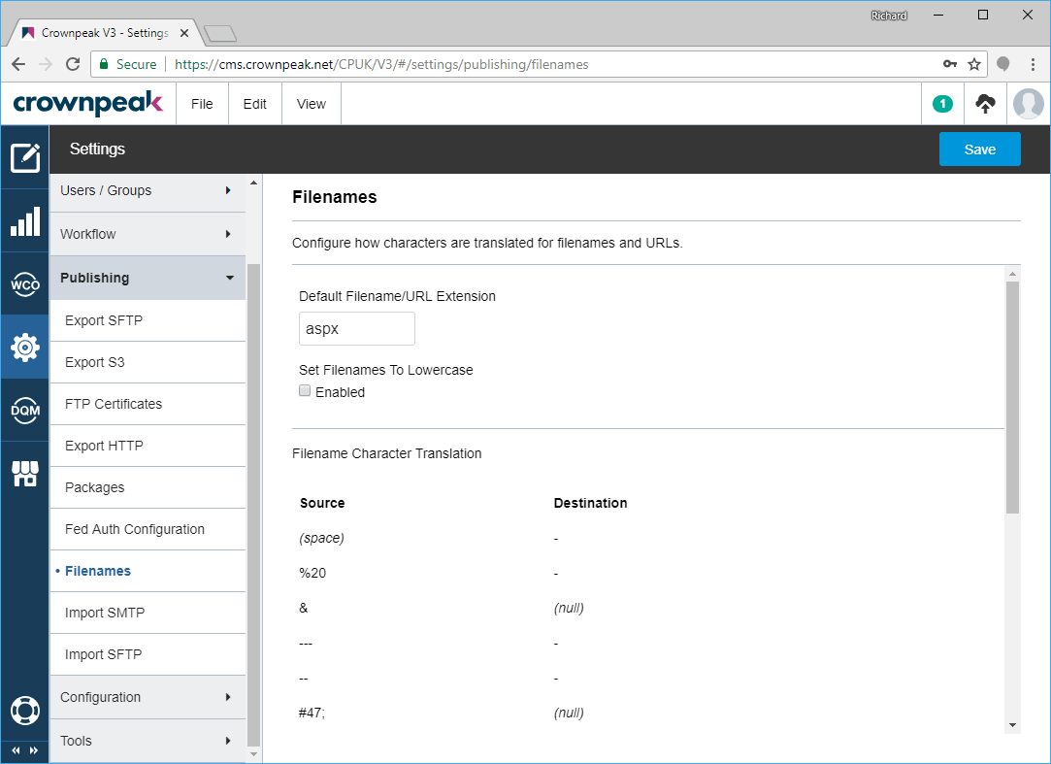
Still with me?

Slide 19
Filenames
Settings > Publishing > Filenames
Set default extension, and optionally lower case
  Latter sounds like a good idea – but Java requires WEB-XML in capitals
Also global replacements applied to ALL filenames and/or URLs
  Use sparingly – they’re not able to be overridden locally
There’s also the /System/Filenames template folder
  Also /Filenames inside a Project
This lets you apply filename and URL rules to digital assets

Slide 20
Workflow

Slide 21
Workflow Creation
Workflows can be created in V3
  System > Workflow > Workflows > New Workflow
  No choice of location – will be in /System/Workflows
  You can cut/paste the workflow into a Project after creation
In Volte you can create directly in the project folder if preferred

Slide 22
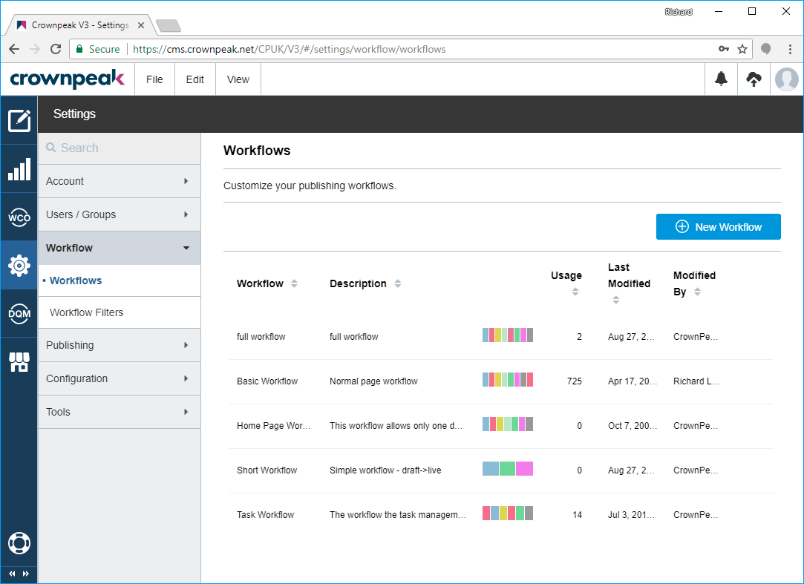
Workflow Creation

Slide 23
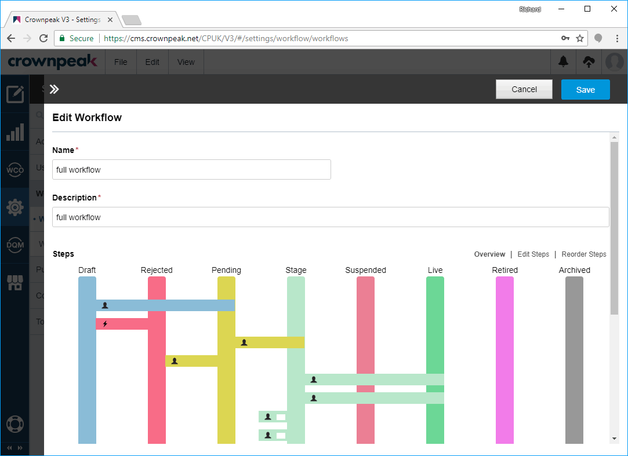
Workflow Creation

Slide 24
Workflow Creation
Workflow states are shown as vertical bars
Transitions are horizontal bars joining states
Go to “Edit Steps” to see individual details
Add/remove transitions in here
Also note “Execute File”
  Pick a DeveloperCS asset
  More control than using the Email Notification option

Slide 25
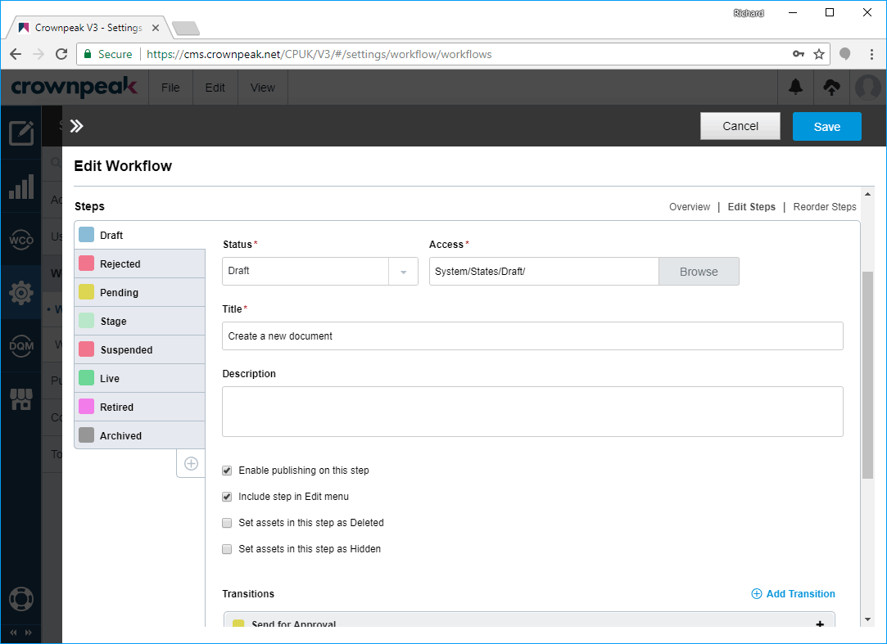
Workflow Creation

Slide 26
Sites and Projects

Slide 27
Sites and Projects
A Site is the root of a published web site
A Project is the collection of templates/code used to make it
When creating a new site, File > New > Site Root
  Check the box if you’re using Component Library
  Otherwise create a new Project inside the new Site Root
  Or use Site Root under Properties and pick a shared project if applicable
Always use this for any new sites created in the CMS
Create a new access group to control permissions for the Project
Lock it down so content authors don’t see it

Slide 28
Project Branching

Slide 29
Project Branching
Currently only available in Volte (coming soon in V3)
Right-click a Project folder and choose Branch
Branches can be compared to other branches as well as merged
Right-click on source and Compare To > Other Name
Click on rows on modal to see details of change
Right-click on source and Merge Into > Other Name
Choose actions and Include (or not) before continuing
  Conflicts must be resolved (double-click) before merging
Merge is not a true merge – it creates a third branch with the results

Slide 30
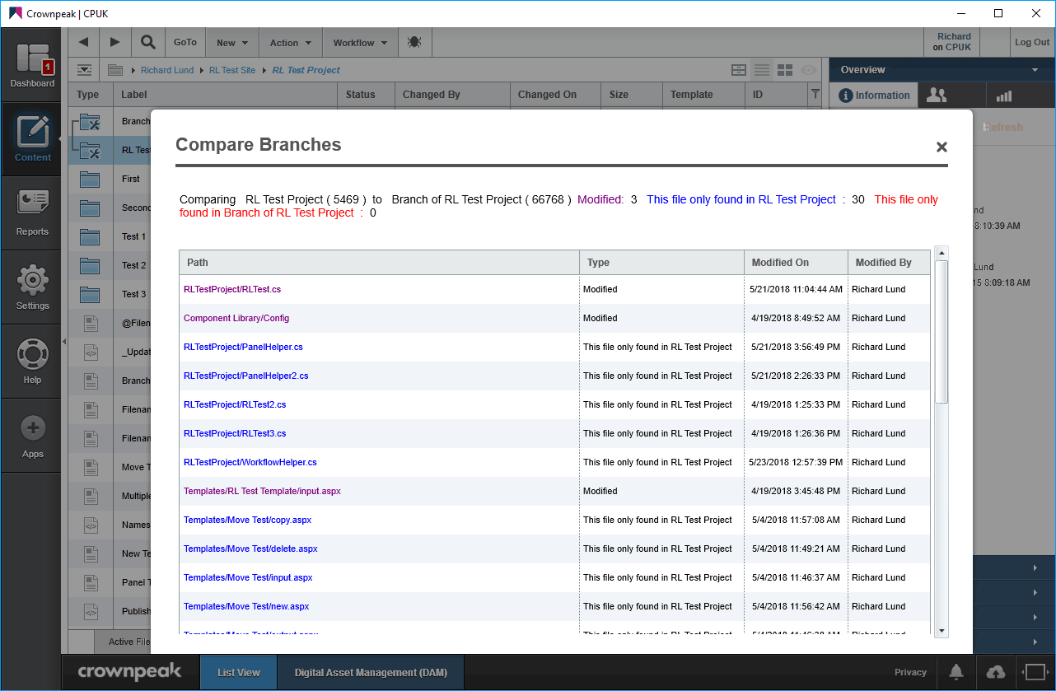
Project Branching

Slide 31
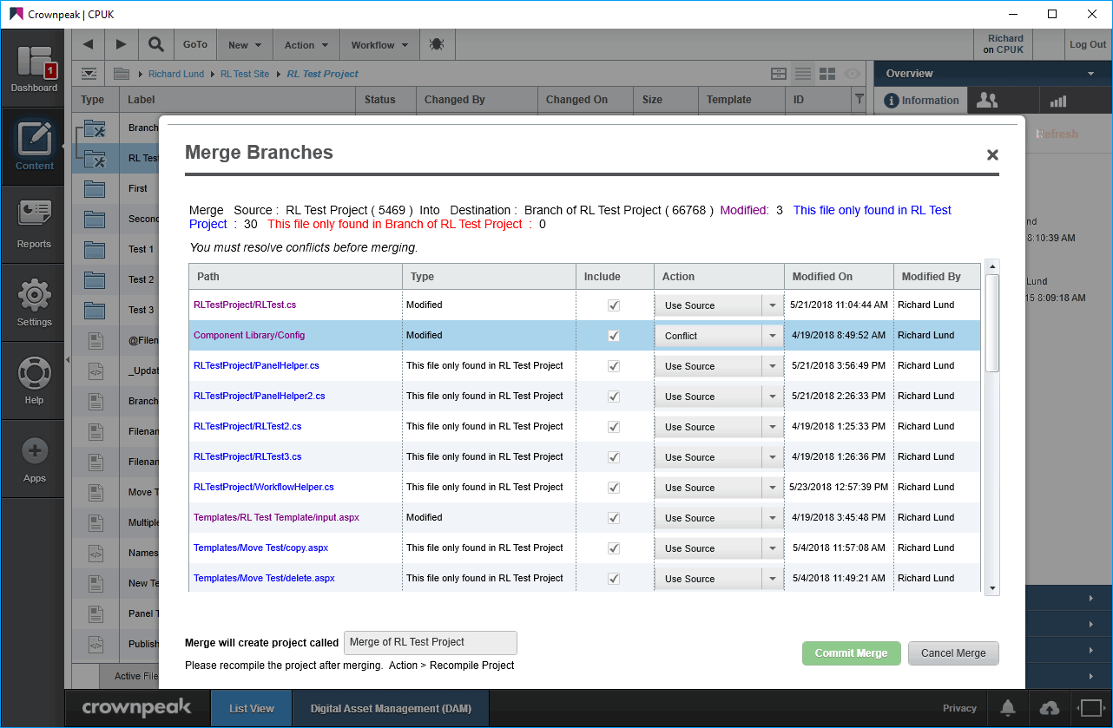
Project Branching

Slide 32
Project Branching
Use Site Root properties to assign a branch to each workflow state
The list of workflow states is populated based on content in the site
  You may need to publish things for everything to show up
Don’t forget to click on Save!

Slide 33
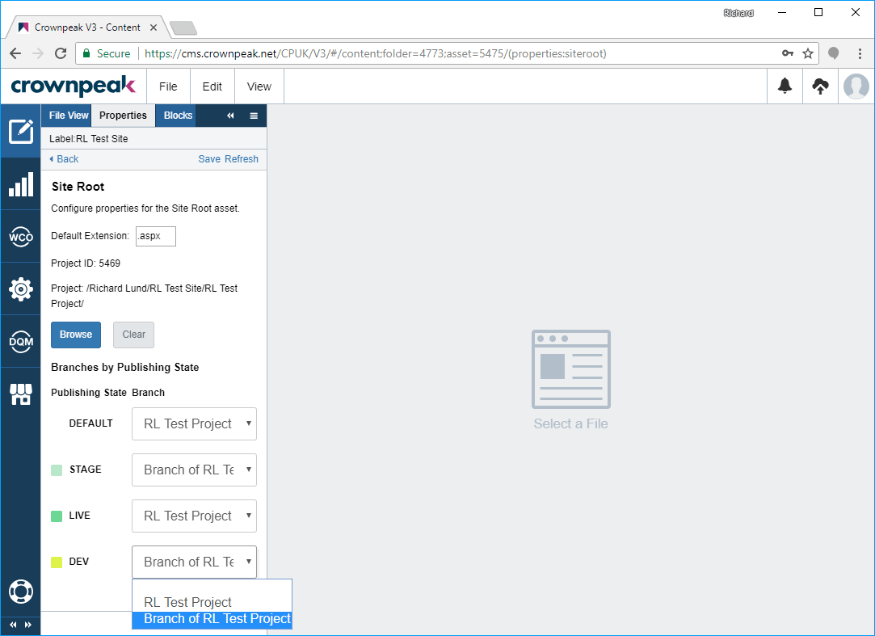
Project Branching

Slide 34
User Permissions

Slide 35
User Permissions
First, create or modify groups in V3
Each checkbox gives that group the right do to the action
  But most of them still have to be turned on in Access permissions
Assign users to groups to give them the rights
Permissions are additive, so you can’t remove a right that a user has
View groups and roles are efficient for simple sites
Problem is if a user is an Editor of site 1, but only a Viewer of site 2
  Only really solvable using site-specific Editor roles, which gets messy

Slide 36
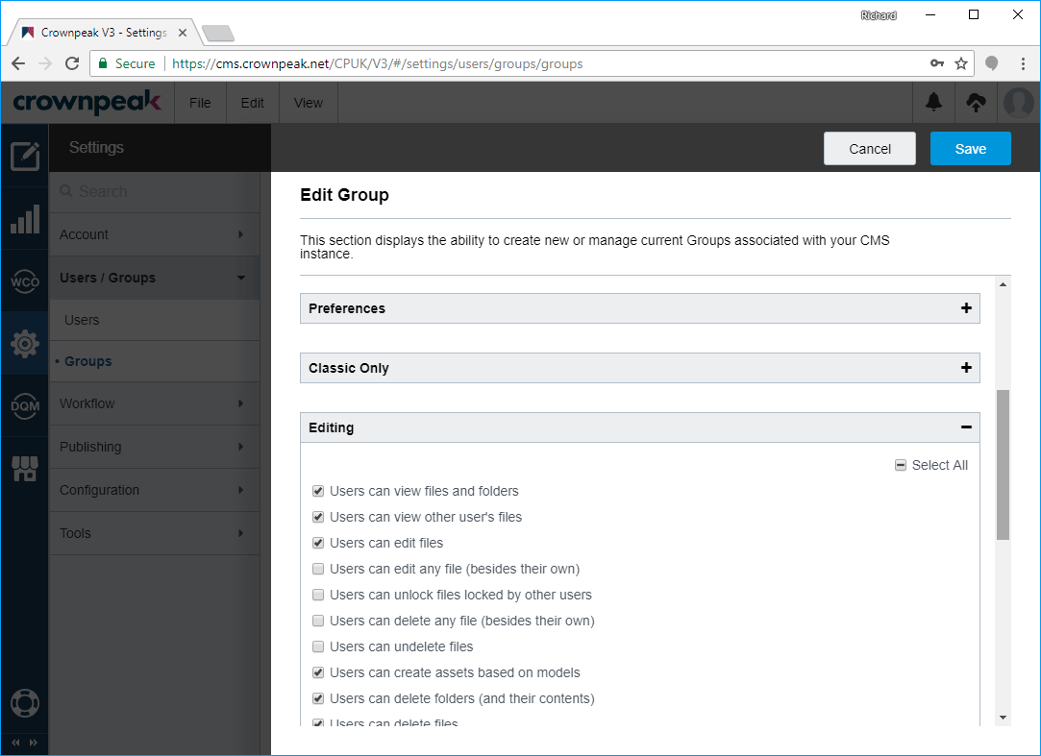
User Permissions

Slide 37
User Permissions
Access is currently only configurable through Volte (V3 coming soon)
Permissions set on a folder apply to all subfolders unless overridden
Click on a group heading to expand and see the detail columns
Be careful of “Users can manage any asset regardless of asset security settings (admin role)” – keep it to Crownpeak only
If an item has no checkbox, that right is not checked on the Group
No report showing where Access rights are set, so use sparingly
Classic has View > User Folder Visibility when looking at a user
Also has Edit > Assume Identity – this won’t stay forever…

Slide 38
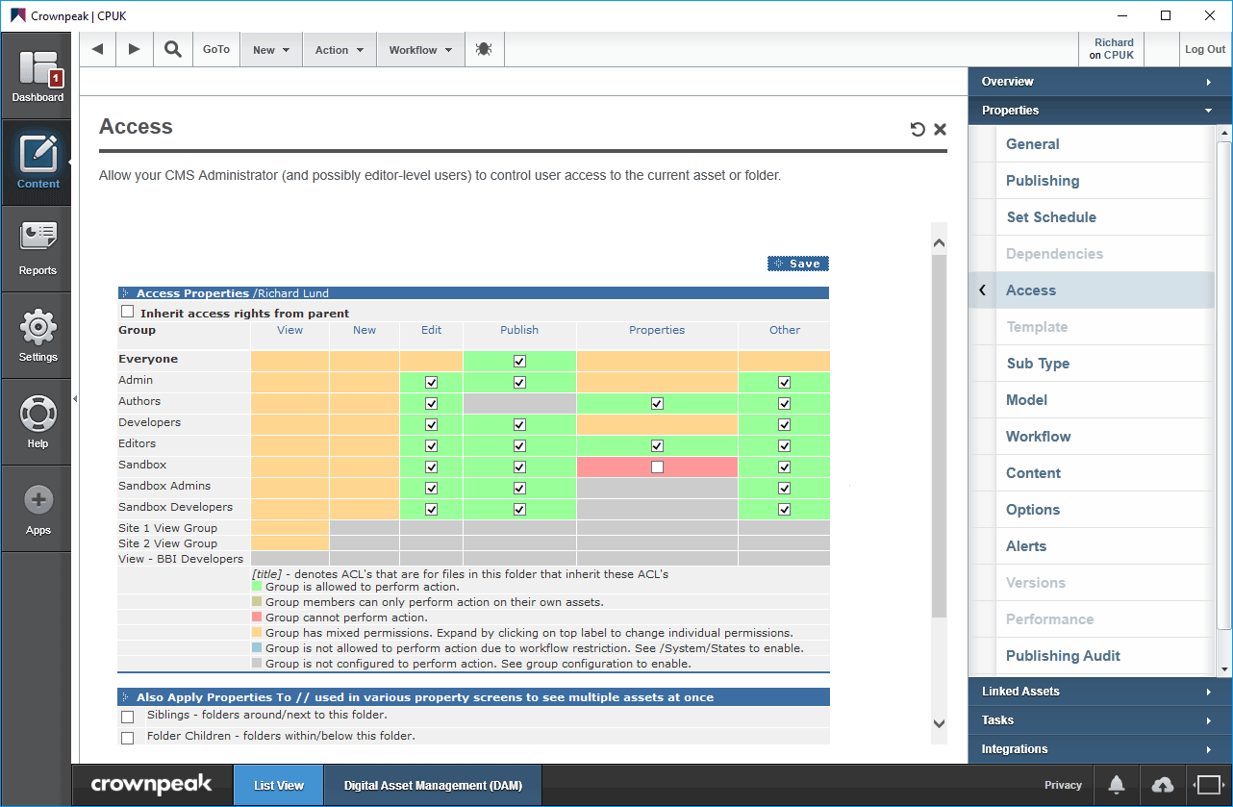
User Permissions

Slide 39
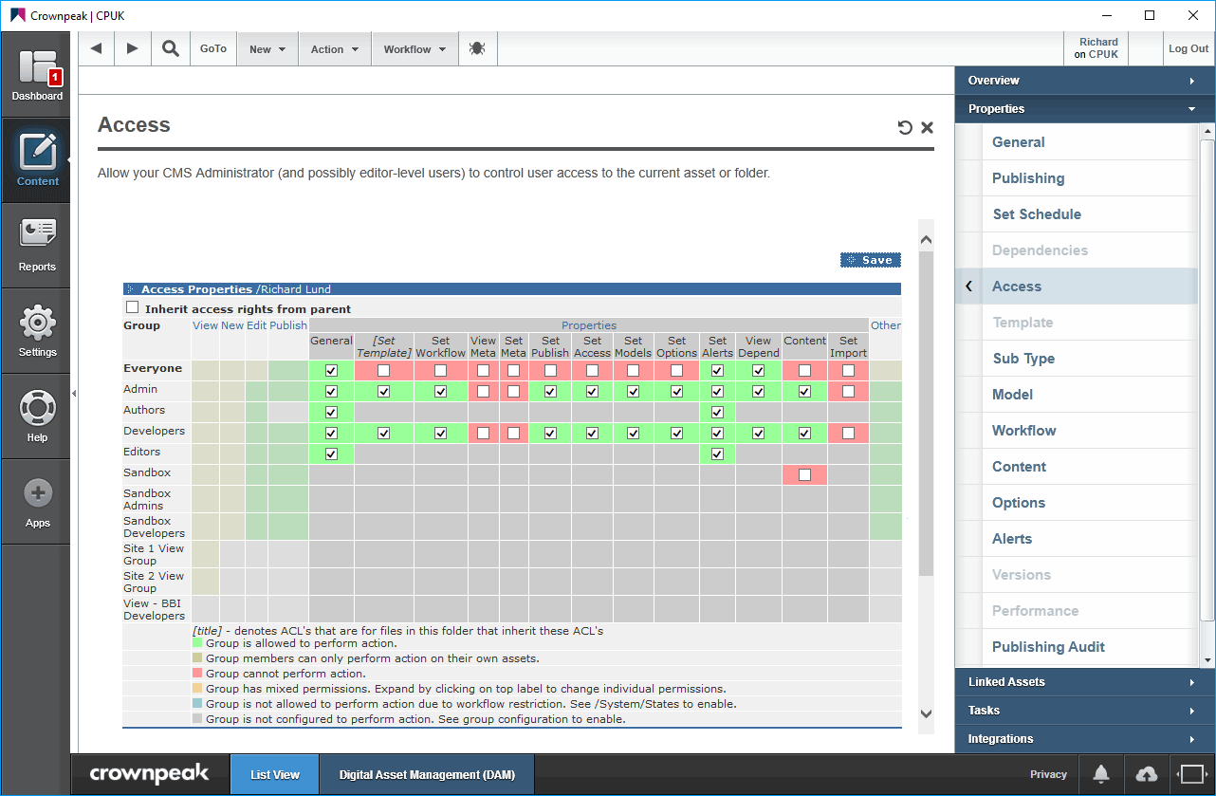
User Permissions

Slide 40
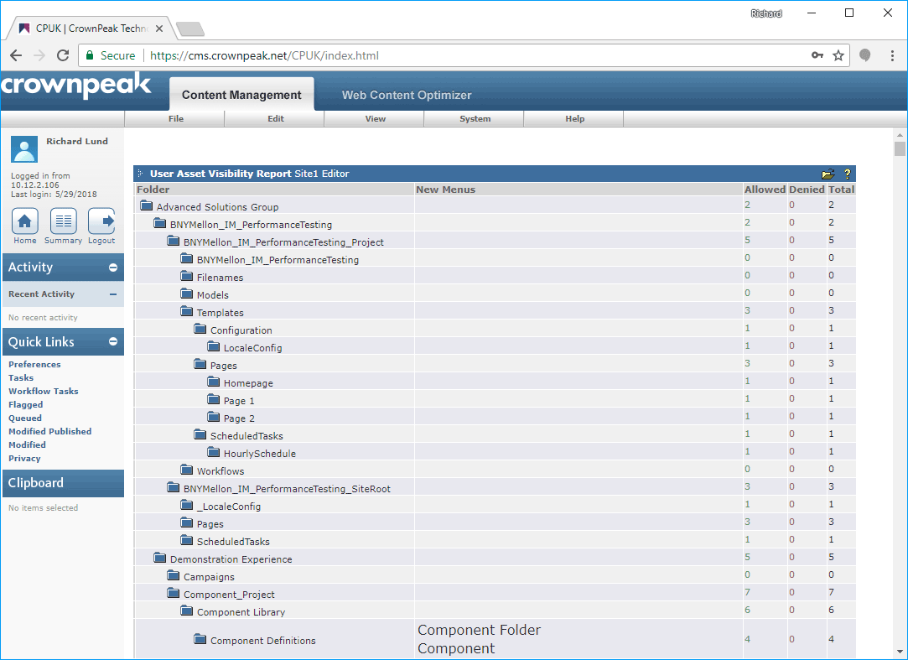
User Permissions

Slide 41
Routing

Slide 42
Routing
Routing is the ability to select an arbitrary workflow state
Generally kept to administrators only
Controlled by “Users can route workflow documents to any workflow step” right in Group
The “Route Additional Assets” button publishes more at the same time
A good way to ensure that the whole site is published up-front
Usually choose Neighborhood, choose status, and hit return
  Without hitting return, nothing happens
  Be patient – results can take some time
Click Confirm Selection when you’re done

Slide 43
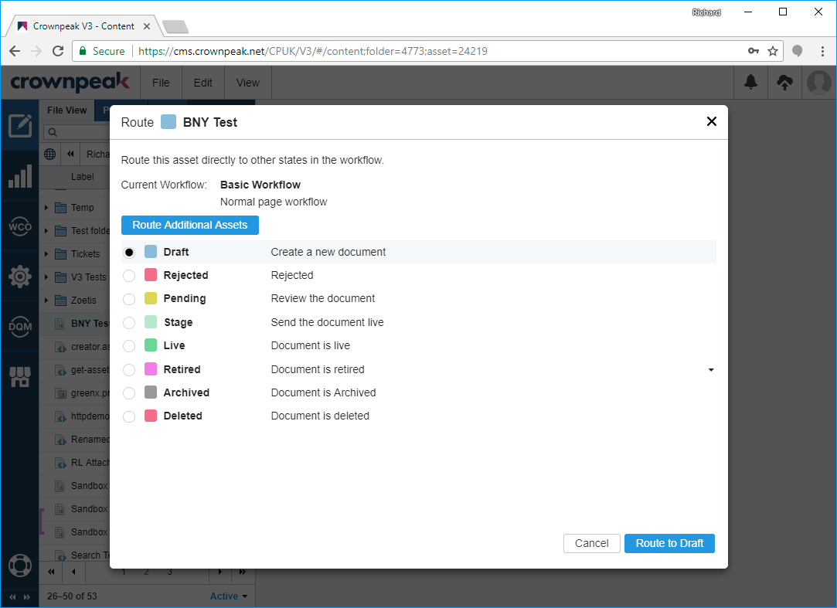
Routing

Slide 44
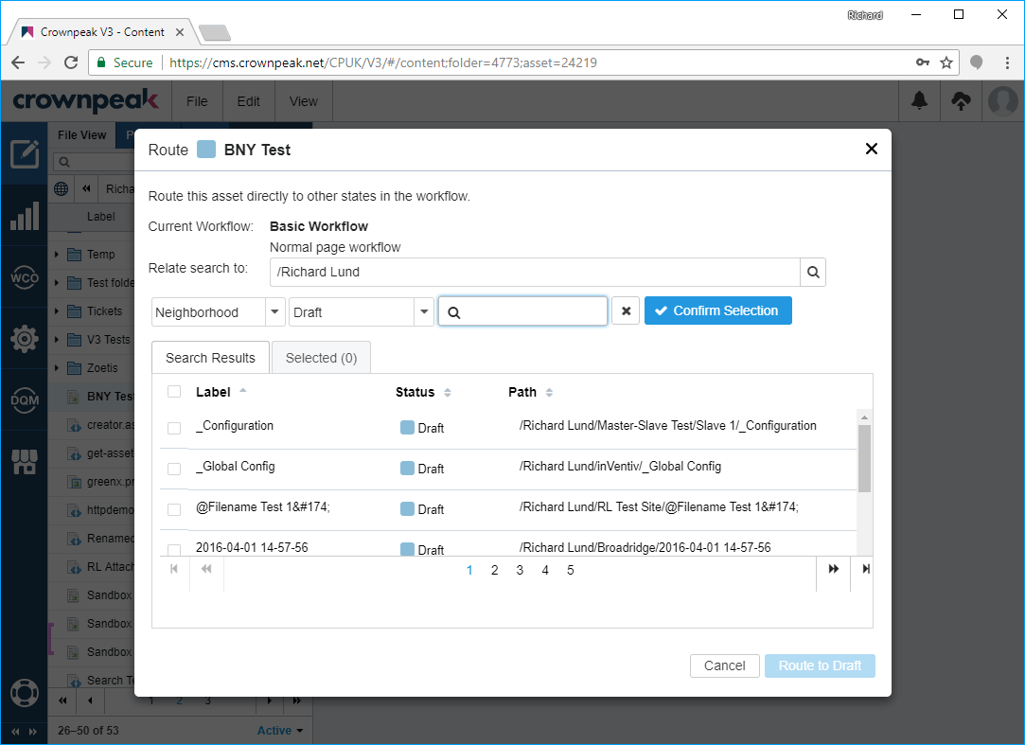
Routing

